Slide 1
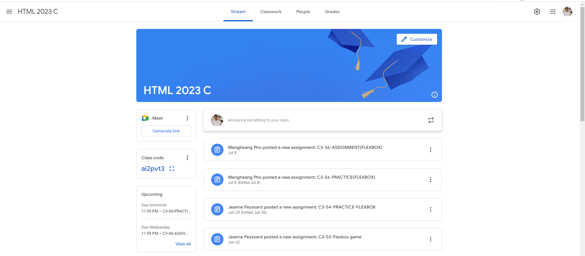
Identify root components of website below

Slide 2
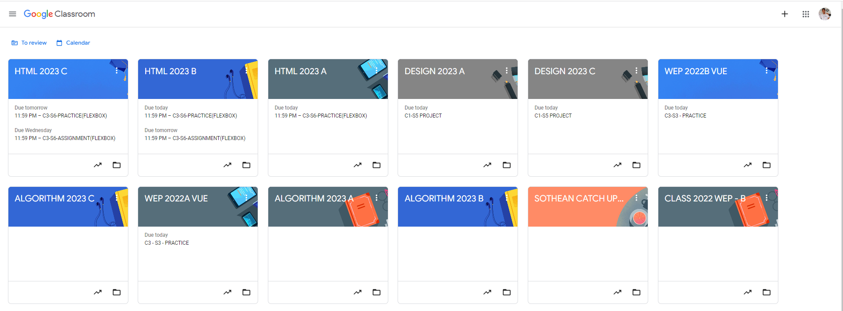
Root div
- Height: 100vh
content
nav
Flex: 0
header
Flex: 0
Flex: 1

Slide 3
Head
Main

Slide 4

Header-left
Navigation
Header-right
Title
Content

Slide 5
Sidebar
Content

Slide 6
Content 1
Content 2
Content 3
Content 4
Content 5

